Slide 1

Green Pace
Security Policy Presentation
Developer: Julianne Takaya

Slide 2

OVERVIEW: DEFENSE IN DEPTH
The Green Pace Security Policy introduces practices and polices that will protect the organization’s data and system from attack. It works on a layered defense in depth strategy illustrated below.

Slide 3
THREATS MATRIX
Likely: High chance to cause an exploit, but low remediation cost
Priority: High chance to cause an exploit, and high remediation cost
Low Priority: Unlikely to cause an exploit with a low remediation cost
Unlikely: Unlikely to cause an exploit, but high remediation cost
Likely STD-002-CPP STD-003-CPP | Priority STD-004-CPP STD-005-CPP STD-007-CPP STD-010-CPP
Low priority STD-001-CPP STD-006-CPP STD-009-CPP | Unlikely STD-008-CPP

Slide 4
10 PRINCIPLES
Validate Input Data
STD-004-CPP
Heed Complier Warnings
STD-001-CPP
STD-009-CPP
Architect and Design for Security Policies
STD-002-CPP
STD-003-CPP
STD-008-CPP
Keep It Simple
Default Deny
Adhere to the Principle of Least Privilege
Sanitize Data Sent to Other Systems
STD-004-CPP
Practice Defense in Depth
STD-005-CPP
STD-007-CPP
STD-010-CPP
Use Effective Quality Assurance Techniques
STD-006-CPP
Adopt a Secure Coding Standard

Slide 5
CODING STANDARDS
STD-001-CPP -- Never qualify a reference type with const or volatile
STD-002-CPP -- Ensure that division and remainder operations do not result in divide-by-zero errors
STD-003-CPP -- Do not attempt to create a std:string from a null pointer
STD-004-CPP -- Exclude user input from format strings
STD-005-CPP -- Allocate sufficient memory for an object
STD-006-CPP -- Use a static assertion to test the value of a constant expression
STD-007-CPP -- Do not abruptly terminate the program
STD-008-CPP -- Do not invoke virtual functions from constructors or destructors
STD-009-CPP -- Do not access a closed file
STD-010-CPP -- Guarantee that container indices and iterators are within the valid range

Slide 6
ENCRYPTION POLICIES
Encryption at Rest | Data stored on internal servers, cloud servers, desktops, laptops, and external storage devices should be encrypted. No data should be stored in plain text. This protects against an attacker gaining access to data through compromised hardware.
Encryption in flight | When data is transferred from one place to another it must be encrypted. This includes data being sent from the client to Green Pace systems, internal transfer of data, and data being sent from Green Pace to the client. This protects data in the case of interception.
Encryption in use | While data is in use, being read, processed, or modified, it is in its most vulnerable state as it is being directly accessed by a human. To protect data while in use it must remain encrypted unless necessary. Additionally, access to data should be restricted to only those individuals who require access.

Slide 7
TRIPLE-A POLICIES
Authentication | Verify a user’s identity before allowing access to any system. This can be done through a user ID and password. Authentication ensures the person accessing the data has the proper clearance to do so.
Authorization | Not every individual requires access to all systems. Access should be limited based on job role and responsibilities.
Accounting | Any access should be accounted for. A time-stamped record of each log-in and log-out, as well as any failed log-in attempts should be automatically tracked by the system. A record of what data was accessed and any action that occurred to that data, whether it was modified or downloaded, should be kept.

Slide 8
Unit Testing
Tests individual components of an application in isolation to verify they work as expected.
Helps find bugs and defects early in development, reducing cost of debugging later
Helps programmers write clean, modular code by ensuring each part behaves correctly.
Can be automated to save time and money
Excellent for testing edge cases

Slide 9
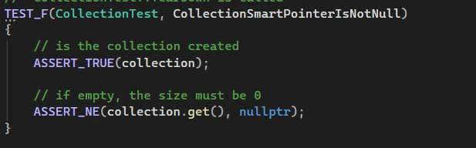
Collection Smart Pointer Is Not Null
Ensures the collection exists
Ensures the collection pointer is pointing to an object.

Slide 10
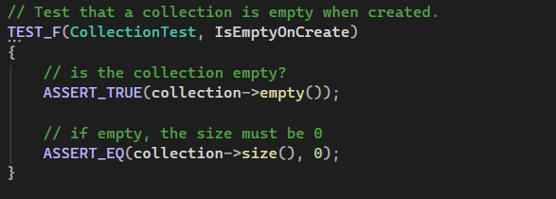
Is Empty On Create
Vector must be empty upon creation to prevent data from being saved unintentionally.
Test shows new vector is empty upon creation

Slide 11
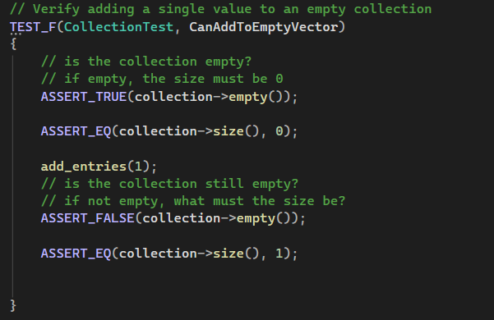
Can Add To Empty Vector
Empty vectors must be able to receive entries.
Test shows empty collection increase size to one after entry is added.

Slide 12
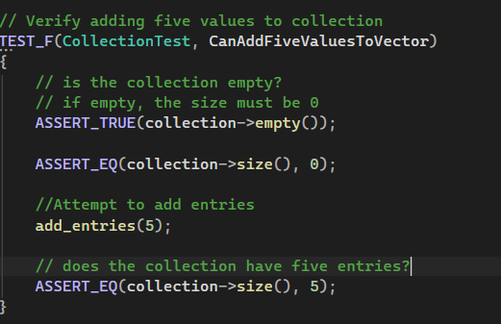
Can Add Five Values To Vector
Collection must accept entries of any size.
Test shows collection can receive multiple entries.
Could add higher values to test edge cases

Slide 13
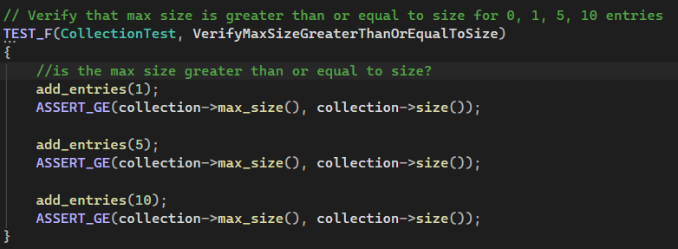

Verify Max Size Greater Than Or Equal To Size
Max Size of a vector must be greater than or equal to the actual size of a vector to prevent overflow
Can add more test cases for upper limits of vector sizes

Slide 14
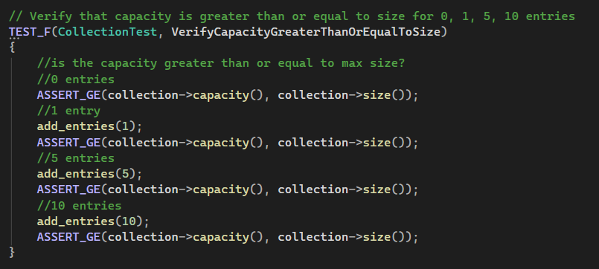
Verify Capacity Greater Than or Equal to Size
Ensuring the capacity is greater than or equal to the size of a collection prevents overflow
Test shows collection capacity is greater than or equal to the collection size after adding entries

Slide 15
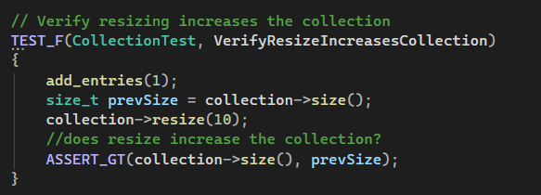
Verify Resize Increases Collection
Collection resize must work accurately to ensure adequate memory is used
Test shows collection size is greater than previous size after resize

Slide 16
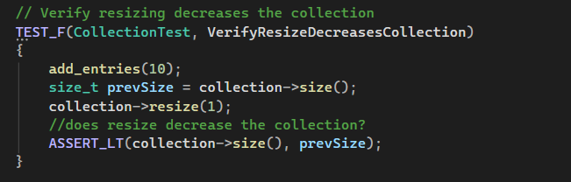
Verify Resize Decreases Collection
Test shows collection size is less than the previous size after resize

Slide 17
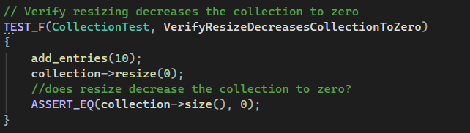
Verify Resize Decreases Collection To Zero
Test shows collection size is equal to zero after resize
This is an example of an edge case

Slide 18
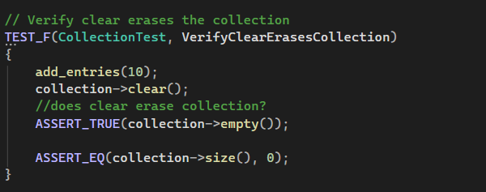
Verify Clear Erases Collection
Collections must be cleared of all data.
Test shows collection is empty and size is zero after clear

Slide 19
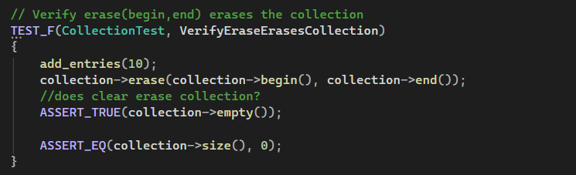

Verify Erase Erases Collection
Collections must be erased in entirety to protect data that is no longer needed by the system
Test shows collection is empty and size zero after erase is called

Slide 20
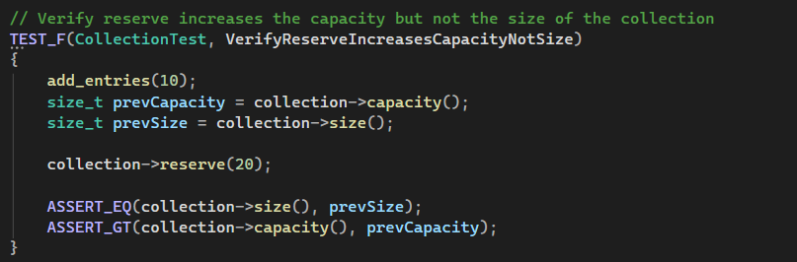
Verify Reserve Increases Capacity Not Size
Reserve saves memory in anticipation of collection size, ensuring adequate memory is allocated.
Allocating memory should not increase collection size
Test shows size is equal to previous size
Test shows capacity is greater than previous capacity

Slide 21
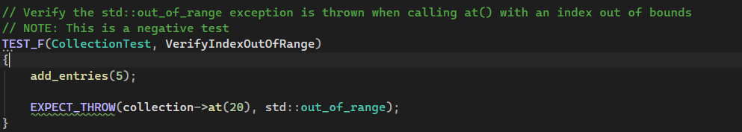
Verify Index Out Of Range
This is an example of a negative test
Attempts to access entries out of range should be rejected
Test shows attempt to access out of range index successfully throws and out-of-range exception.

Slide 22
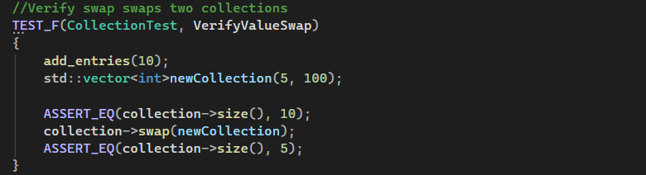
Verify Value Swap
Data in collections should be able to be swapped to a new collection.
Test adds ten entries to existing collection.
Test creates a newCollection with five entries initialized with value 100
Test shows collection size is equal to ten, swaps collection with newCollection, then shows collection size is equal to five.

Slide 23
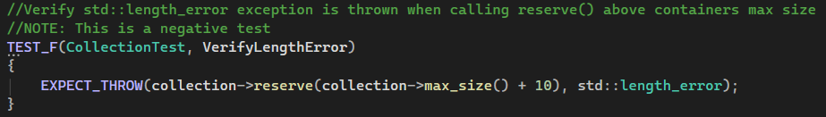
Verify Length Error
This is an example of a negative test
Collections can not reserve more memory than a containers max size.
Test attempts to reserve space above a containers max size.
Test successfully throws length_error

Slide 24

Always Fail
This is an example of a failed test for demonstration

Slide 25

AUTOMATION SUMMARY

Slide 26
TOOLS
Pre-Production
Assess and Plan
Determine likely threats
Regulatory requirements
Design
Adhere to best practices
Use test-driven design
Build
Secure the build
Use only trusted repositories
Verify and Test
Use static testing to scan for vulnerabilities (C++Check, CodeSonar, etc.)
Use unit tests to ensure code functions as intended (GTest, CTest, etc.)
Production
Transition and Health Check
Penetration testing (manual or automated)
Set security settings
Monitor and Detect
Log collection
Event alerting
Intrusion detecting
Respond
Block attacks
Maintain and Stabilize
Return to stable state after compromise or attack

Slide 27
RISKS AND BENEFITS
Early Security Implementation
Delayed Security Implementation
Seamless integration during development and planning
Reduce the risk of vulnerabilities
Proactive commitment to safeguarding data
Encourages consistency across the codebase
May face resistance or support
Increase costs
Retrofitting security features is difficult and less effective
Increase risk of data breaches vulnerabilities

Slide 28
RECOMMENDATIONS
A policy only works if it is followed consistently
All developers should be trained in the new policy and DevSecOps
The policy should be open to changes as the threat landscape changes
Any changes in the policy should be communicated to all developers
Following the security policy should be a condition of employment

Slide 29
CONCLUSIONS
Security will be implemented at the earliest stages of production
All relevant associates will receive thorough training on security development practices and the current policy
Enforcement of the security policy will be implemented.
Applications will not be deployed until all security policy requirements have been met.
The security policy will be reviewed and updated regularly to maintain effectiveness
Automated tests will be used regularly to ensure applications maintain security.

Slide 30
REFERENCES
Carnegie Mellon University. (2026, January 1). Sei Cert C++ coding standard | CERT SECURE CODING. Software Engineering Institute. https://cmu-sei.github.io/secure-coding-standards/sei-cert-cpp-coding-standard/

